Slide 1
Trivadis Technology Radar
Guido Schmutz
@gschmutz
http://guidoschmutz@wordpress.com

Slide 2
What is a Technology Radar?

Slide 3
What is a Technology Radar?
Each of the items is classified in one of these rings:
Adopt: We can clearly recommend this technology. We have used it for longer period of time in many teams and it has proven to be stable and useful.
Trial: We have used it with success and recommend to have a closer look at the technology in this ring. The goal of items here is to look at them more closely, with the goal to bring them to the adopt level.
Assess: We have tried it out and we find it promising. We recommend having a look at these items when you face a specific need for the technology in your project.
Hold: This category is a bit special. Unlike the others, we recommend to stop doing or using something. That does not mean that there are bad and it often might be ok to use them in existing projects. But we move things here if we think we shouldn't do them anymore - because we see better options or alternatives now.

Slide 4
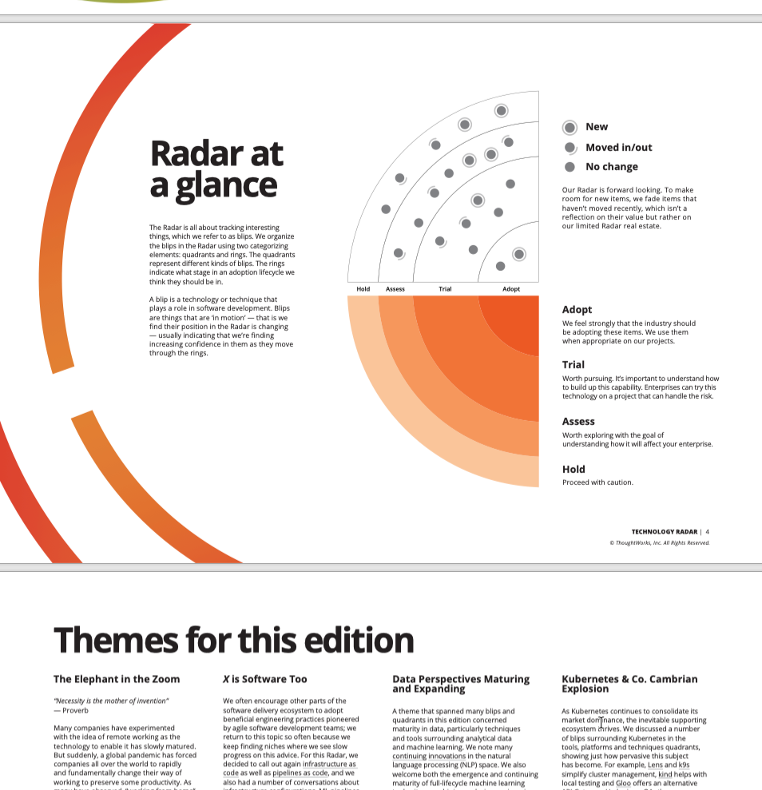
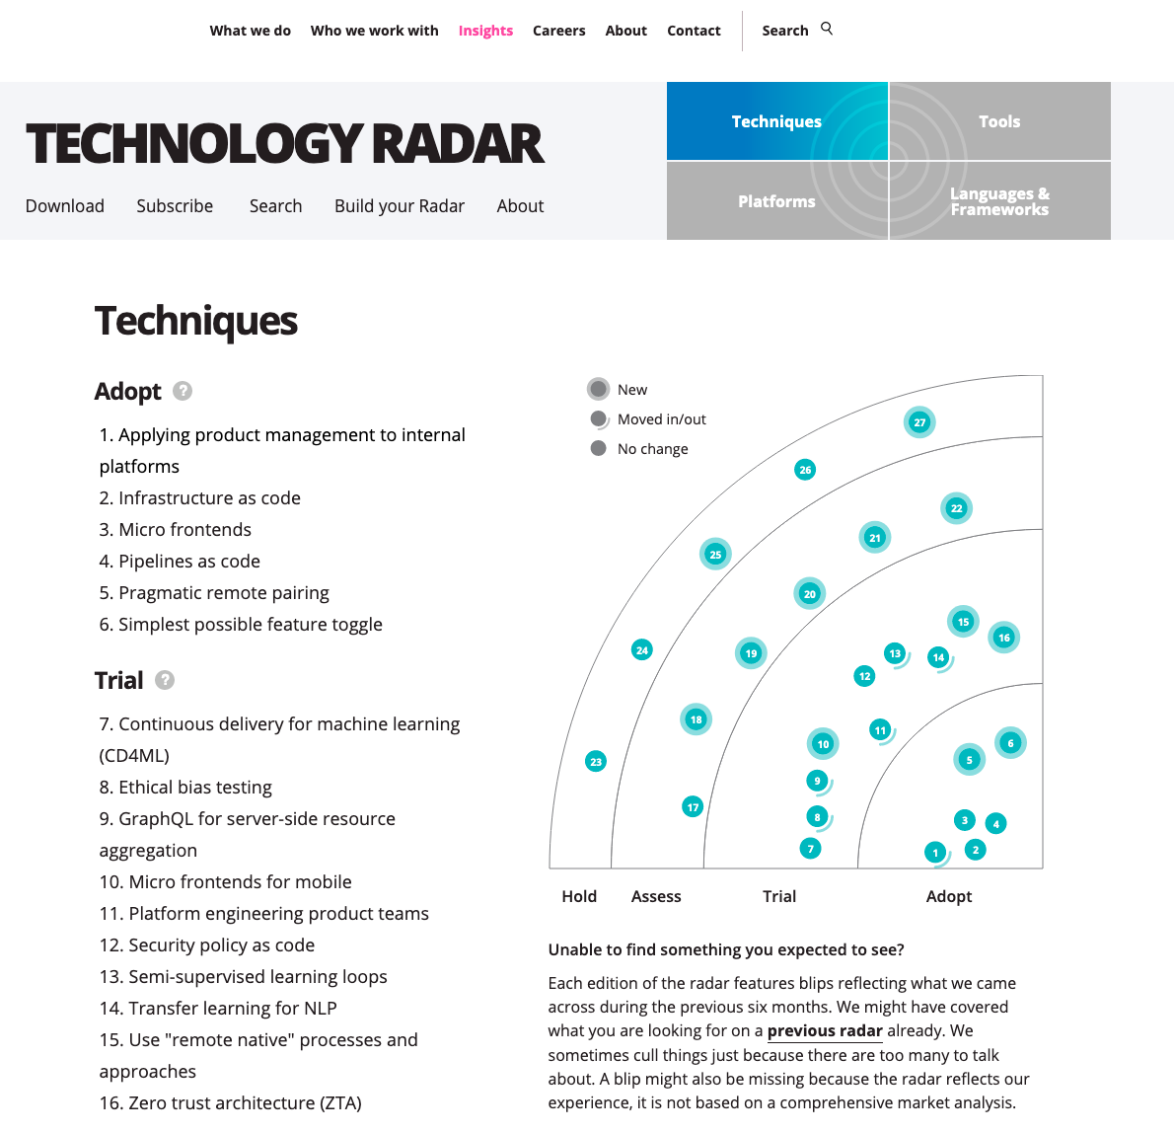
Thought Works https://www.thoughtworks.com/radar

Slide 5
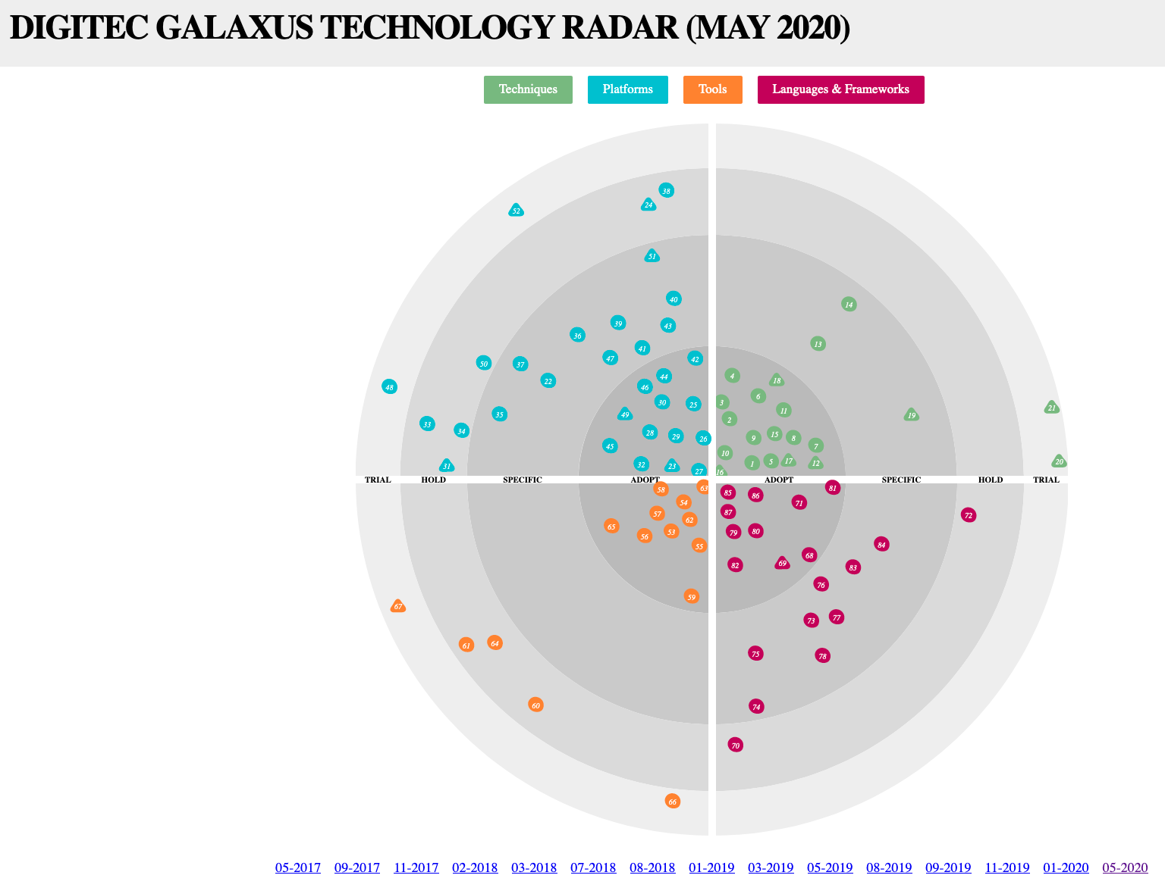
Digitec / Galaxus https://www.galaxus.ch/techradar/

Slide 6
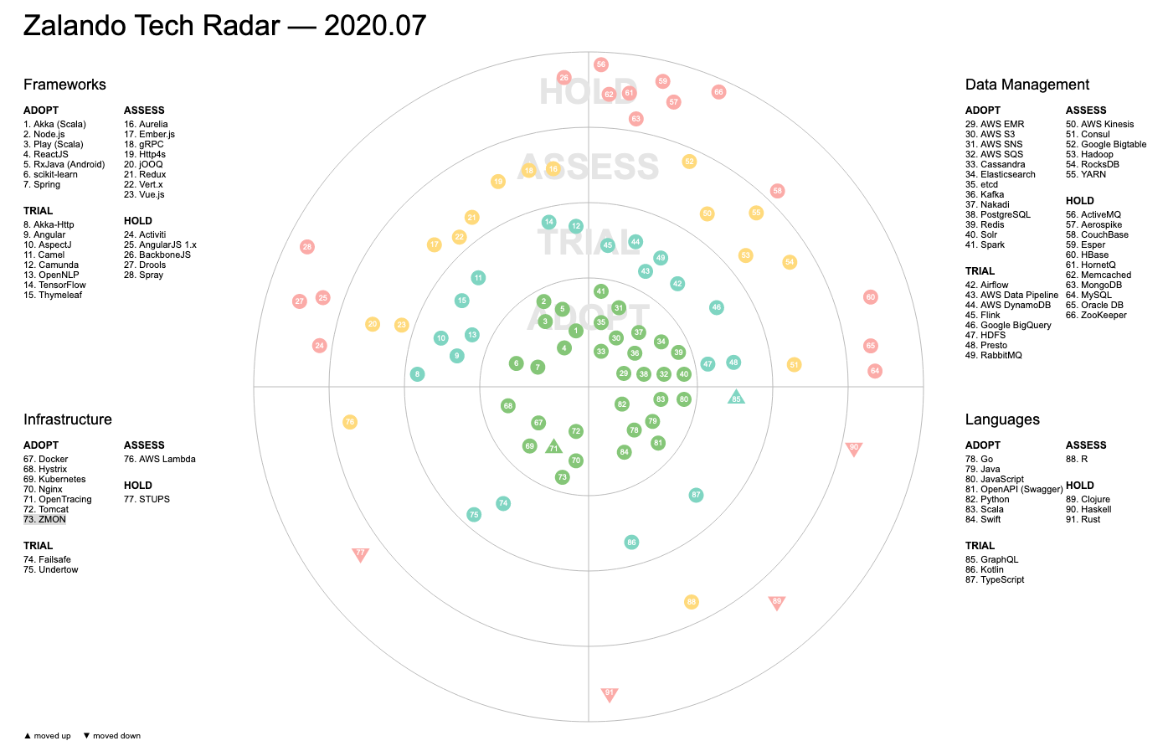
Zalando https://opensource.zalando.com/tech-radar/

Slide 7
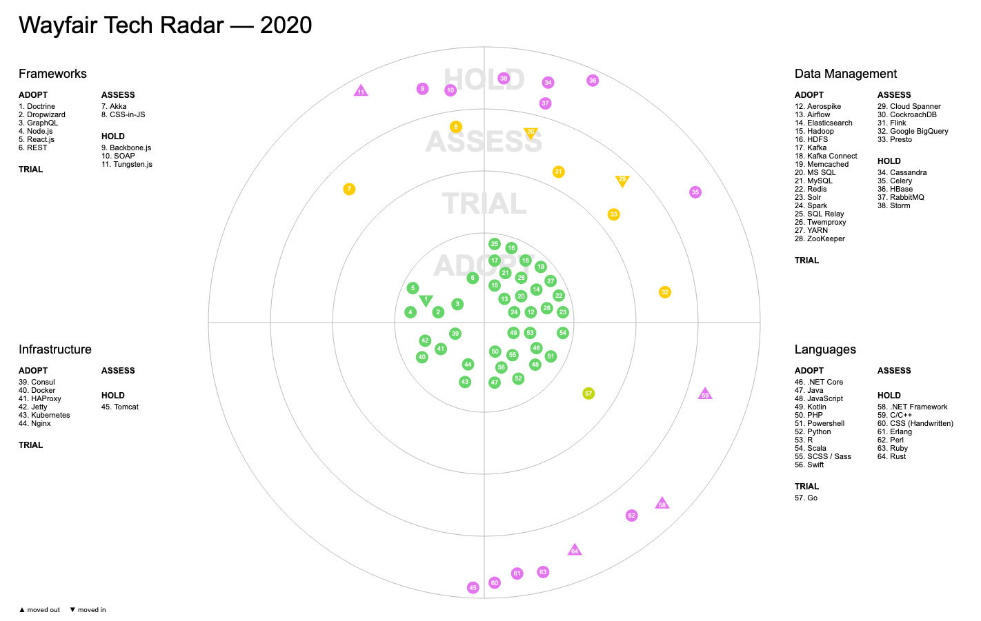
Wayfair https://storage.googleapis.com/wf-techradar-prod/index.html

Slide 8
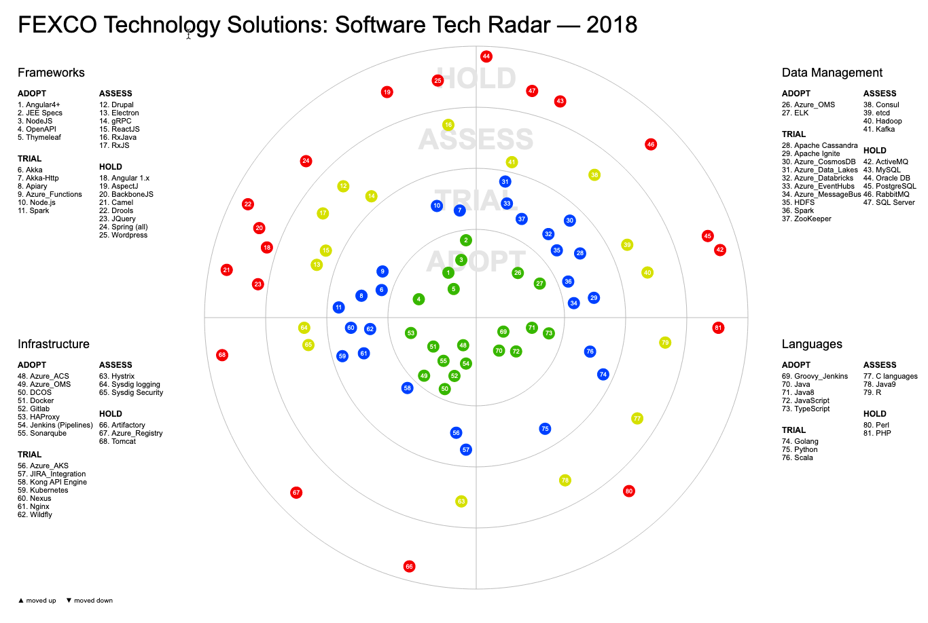
FEXCO Tech Radar https://techblog.fexcofts.com/techradar2018Q1//

Slide 9
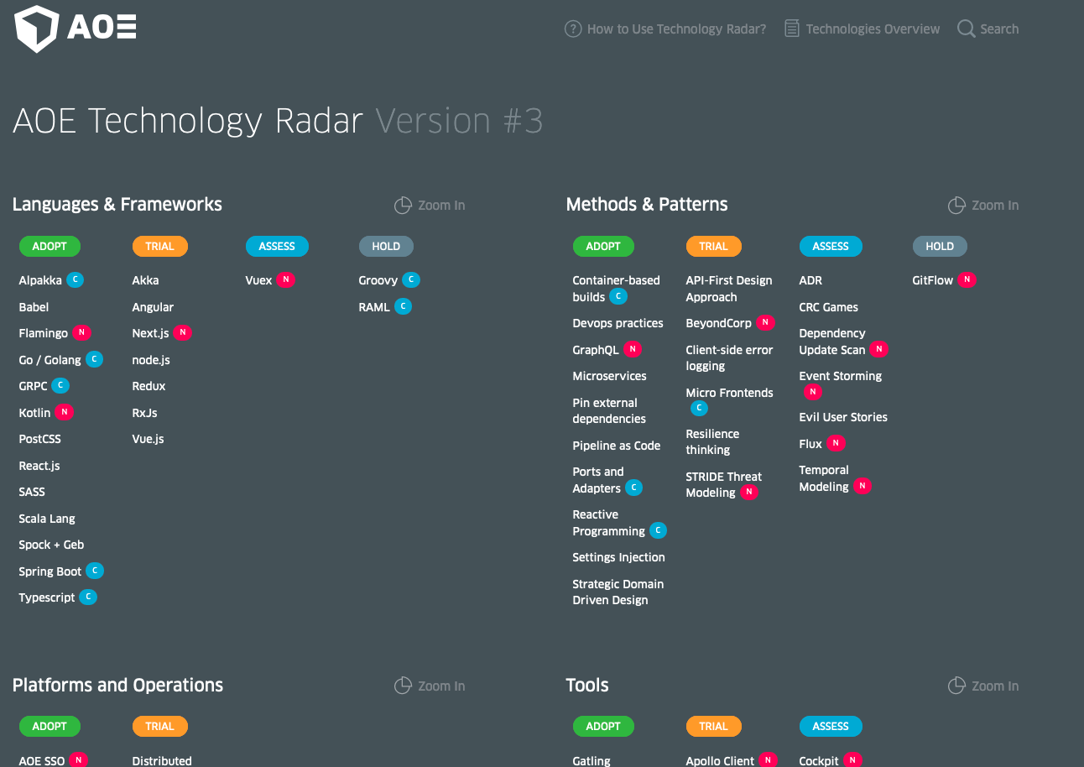
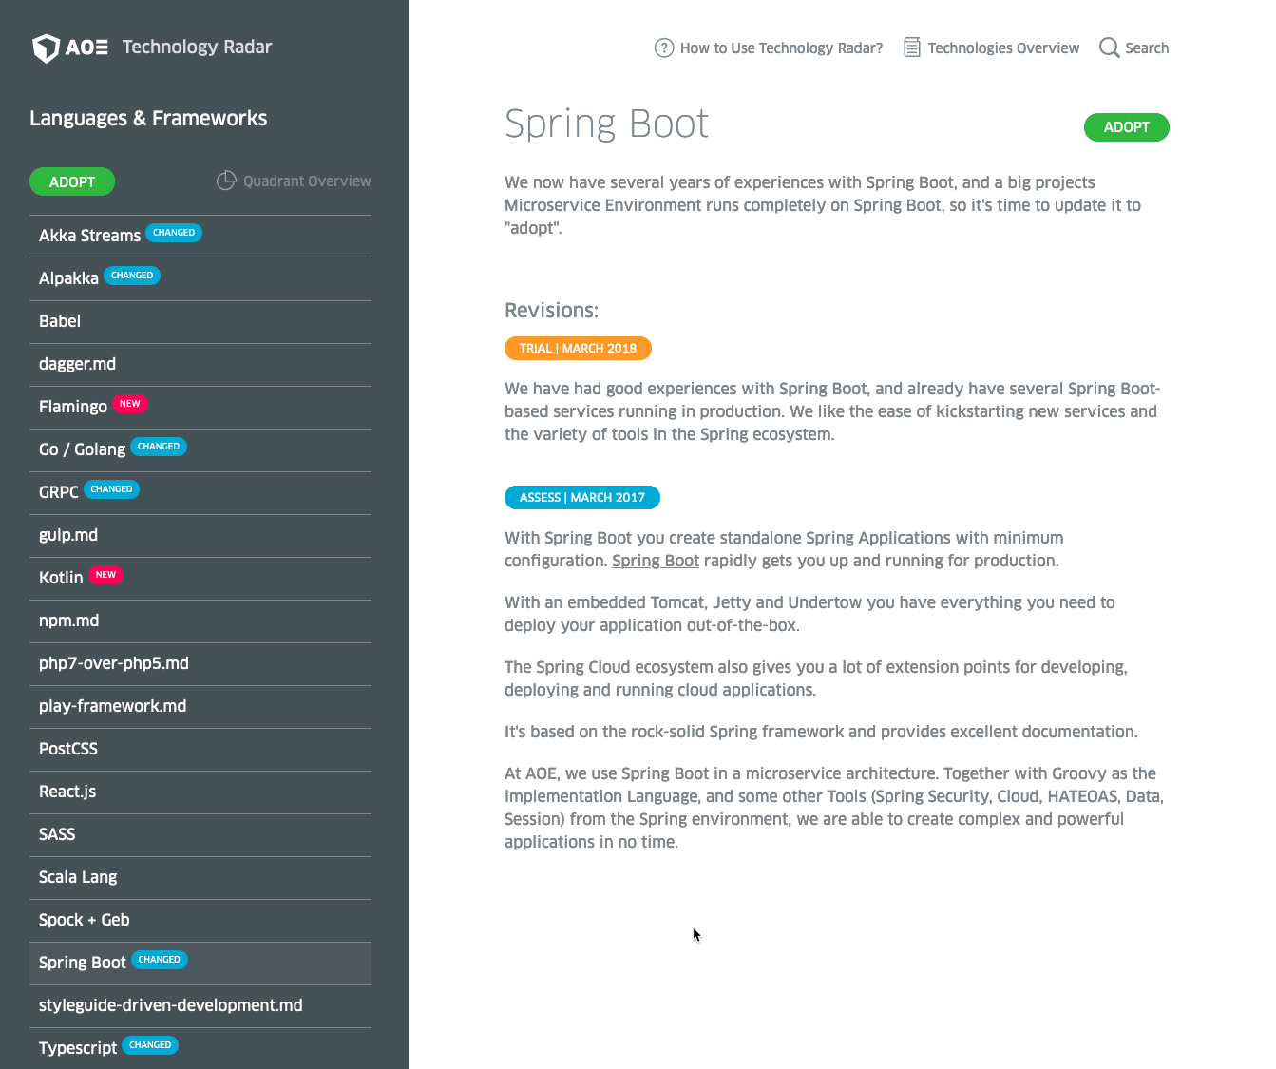
AOE Technology Radar https://www.aoe.com/techradar/index.html

Slide 10
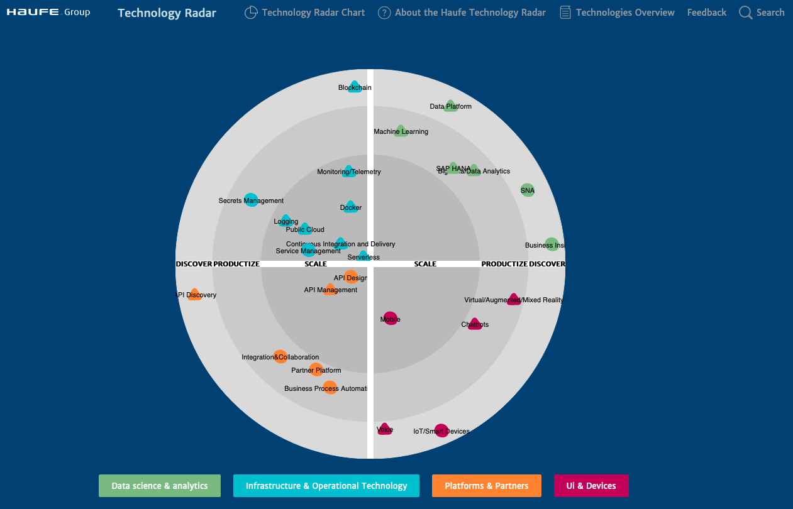
Haufe https://techradar.haufe.io/techradar/radar-chart.html

Slide 11
Trivadis Technology Radar

Slide 12
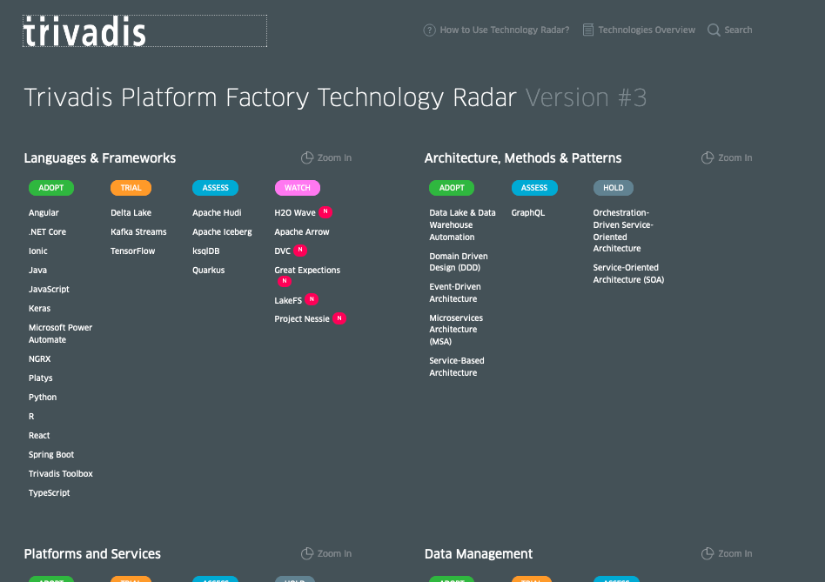
Trivadis Technology Radar
Source available in the following GitHub private repository: https://github.com/TrivadisPF/trivadis-technology-radar
Deployed in AWS Lightsail: http://52.28.188.34:28540/techradar/
Can be installed locally using docker-compose: https://github.com/TrivadisPF/trivadis-technology-radar/blob/master/deployment/README.md

Slide 13
Maintaining the Technology Radar
A technology is specified as a Markdown file, placed into one of the subfolders inside folder radar
Subfolders determine the date when the technology has been added
Each file has a front-matter header where the attributes of the item are listed
Attributes ring and quadrant have to be one of the values shown on the next page
---
title: "React"
ring: adopt
quadrant: languages-and-frameworks
---
Text goes here. You can use **markdown** here.

Slide 14
Maintaining the Technology Radar (II)
Following front-matter attributes are possible:
title: Name of the Item
quadrant: Quadrant. One of languages-and-frameworks, data-management, platforms-and-services, architecture-methods-and-patterns
ring: Ring section in radar. One of trial, assess, adopt, hold,watch
info: (optional) A short textual description of the item (visible in overview pages)
featured: (optional, default "true") If you set this to false, the item will not be visible in the radar quadrants but still be available in the overview.
Suggest adding the following
owner: the person owning the technology
skill (optional): if the skill does not have the same name

Slide 15
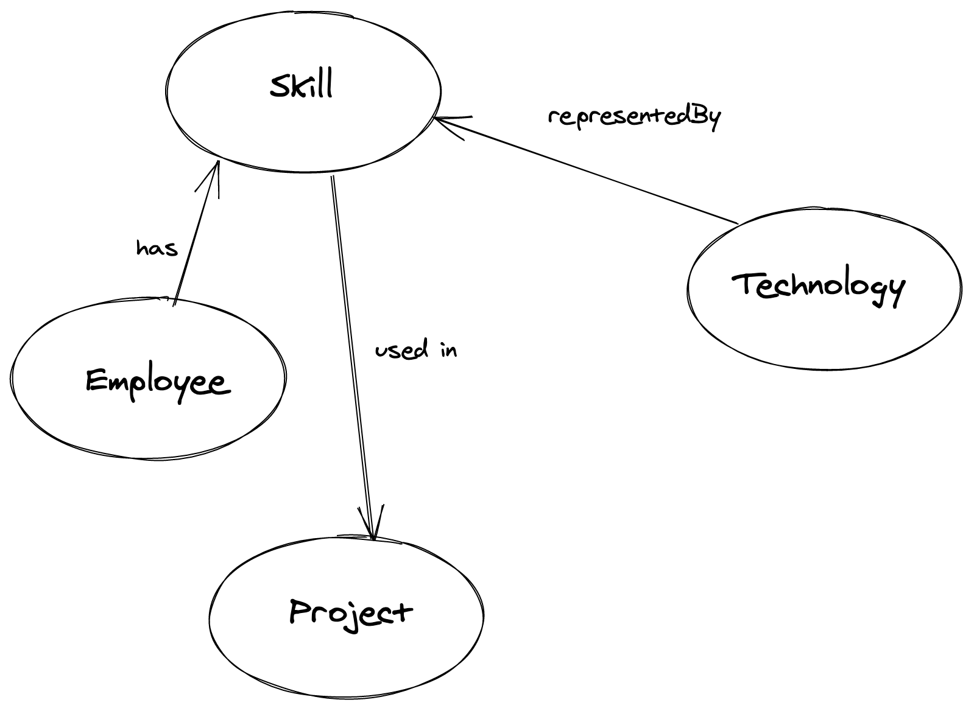
Tech Radar in context

Slide 16
Tasks
Do you want such a technology radar for Trivadis?
Are the quadrants the one one we want? Should we replace one by another?
How to treat Cloud Technology? One radar per Cloud with some technologies showing up in multiple ones?
Should it be internal or external?
What technologies are missing?

Slide 17































Solution Framework v4-2020-03-17
Product based (Low Code)
Apex
DevOps
Azure DevOps
LogicApps
Platforms / Operation
☁ - Cloud Platforms
Analysis / AI
«R»
Angular
Python
JavaScript
- Cloud Platforms
Code / Compute
NGRX
TypeScript
Processing / Storage
Power BI
Visualization / Interaction

Slide 18
















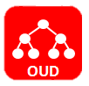












Technology Stack Data Platforms
Storage
Processing
Cloud Computing
Container & (Development) Automation
Security
Notes:
English version

Slide 19


